Slide 1
SQL COMMANDS
Database systems
SCSE

Slide 2
INTRODUCTION
Structure Query Language(SQL) is a database query language used for storing and managing data in Relational DBMS.
SQL was the first commercial language introduced for E.F Codd's Relational model of database.
Today almost all RDBMS(MySql, Oracle, Infomix, Sybase, MS Access) use SQL as the standard database query language.
SQL is used to perform all types of data operations in RDBMS.

Slide 3
Datatypes
Oracle supplies the following built-in datatypes:
character datatypes
CHAR
NCHAR
VARCHAR2 and VARCHAR
NVARCHAR2(
CLOB(character large object)
NCLOB
LONG
NUMBER datatype
DATE datatype
binary datatypes
BLOB
BFILE(to represent the location of binary data)
RAW
LONG RAW

Slide 4
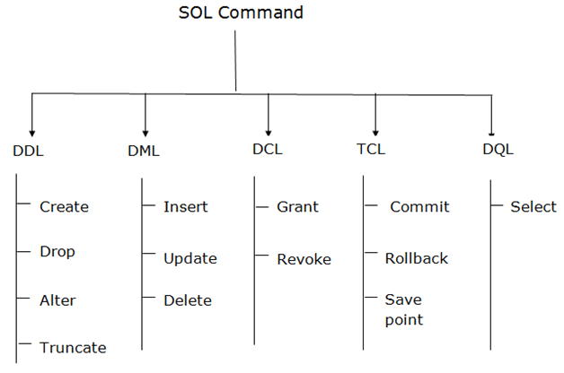

Slide 5
DDL: Data Definition Language
DDL is used for creating and modifying the database objects like table s, indices, views and users.
All DDL commands are auto-committed. That means it saves all the changes permanently in the database.

Slide 6
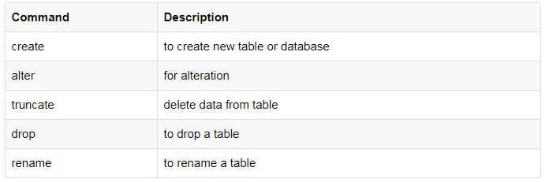

Slide 7
Create Table Statement
Create statement is used to create database schema and to define the type and structure of the data to be stored in the database.
The create table defines each column of table uniquely
Each table column definition is separated from other by comma
SQL statement is terminated by semicolon
Rules for creating a name of table:
Can have up to maximum of 30 characters
A-Z, a-z alphabets and 0-9 numbers are allowed
Should begin with an alphabet
Reserve words are not allowed

Slide 8
Syntax of Create Table Statement
CREATE TABLE table_name ( column1 datatype, column2 datatype, column3 datatype, .... );
Example:
CREATE TABLE Person ( PersonID int, LastName varchar(255), FirstName varchar(255), Address varchar(255), City varchar(255) );

Slide 9
Create table using another table
A copy of an existing table can be created using a combination of the CREATE TABLE statement and the SELECT statement.
Syntax:
CREATE TABLE new_table_name AS SELECT column1, column2,...
FROM existing_table_name;

Slide 10
Example of creating table from another table:
Create table Person2 as select PersonID, FirstName From Persons;

Slide 11
Alter Table Statement
A DBA can make changes to the table structure or column definitions after the table has been created in the database.
The DDL command ALTER TABLE is used to perform such actions.
The ALTER TABLE statement is used to add, drop, rename, and modify a column in a table.

Slide 12
To Add a column in an existing table:
Syntax:
ALTER TABLE table_name ADD column_name datatype;
Example:
ALTER TABLE Person ADD weight_in_Kgs int;

Slide 13
To delete a column in an existing table:
Syntax:
ALTER TABLE table_name DROP COLUMN column_name;
Example:
ALTER TABLE Person DROP COLUMN weight_in_Kgs;

Slide 14
To rename a column in an existing table:
Syntax:
ALTER TABLE table_name RENAME COLUMN existing_column_name
To new_column_name;
Example:
ALTER TABLE Person RENAME COLUMN weight_in_Kgs To Wght_in_kgs;

Slide 15
To modify a table by changing the data type of a column in a table
Syntax:
ALTER TABLE table_name MODIFY column_name datatype;
Example:
ALTER TABLE Person MODIFY Wght_in_kgs varchar(90);

Slide 16
TRUNCATING TABLES
It empties a table completely.
Syntax:
TRUNCATE TABLE table_name;
Example:
Truncate table person;

Slide 17
DESTROYING TABLES
Drop table statement with table name can destroy a specific table
Syntax:
DROP TABLE table_name;
Example:
DROP TABLE person;

Slide 18
RENAME TABLE COMMAND
Syntax-
ALTER TABLE table_name
RENAME to new_table_name;

Slide 19
DML: Data Manipulation Language
DML commands are used for manipulating the data stored in the table and not the table itself.
DML commands are not auto-committed. It means changes are not permanent to database, they can be rolled back.

Slide 20
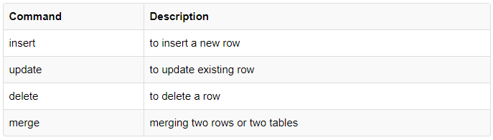

Slide 21
INSERTING DATA INTO TABLE:
The insert operation on inserting a single row:
Creates an empty row in database table
Loads the value passed by insert command into the specified columns
Syntax:
INSERT INTO table_name (Column_name1, Column_name2…) values (expression1, expression2);
Example:
INSERT INTO person (personID, firstname, lastname, address) VALUES (23, ‘ravi’, ‘dubey’, ‘patiala’ );

Slide 22
Inserting data into a table from another table
INSERT INTO <table_name> select <columnname1>,<columnname2> from <table_name>;

Slide 23
VIEWING DATA IN TABLES
The select command is used to retrieve rows selected from one or more tables
To select all rows and all columns:
SELECT Column1,… , Column2 from table_name;
OR
SELECT * from table_name;
Example:
SELECT * FROM person;

Slide 24
Selected columns and all rows
Select<columnname1>,<columnname2>, from <tablename>;
Example: Select Name, Roll_no from Student;

Slide 25
Selected Rows and All Columns
Select * from <tablename> where <condition>;
Example :select * from student where name=‘xyz’;

Slide 26
Selected columns and selected rows
Select <columnname1>,<columnname2> from <tablename> where <condition>;
Example: Select name, roll no from student where roll no=1;

Slide 27
SQL ORDER BY Keyword
The ORDER BY keyword is used to sort the
result-set in ascending or descending order.
The ORDER BY keyword sorts the records
in ascending order by default.
To sort the records in descending order, use the DESC keyword.

Slide 28
ORDER BY Syntax
SELECT column1, column2, ... FROM table_name ORDER BY column1, column2, ... ASC|DESC;
CREATE TABLE Person_detail ( PersonID int, LastName varchar(255), FirstName varchar(255), Address varchar(255), City varchar(255) );
select * from Person_detail order by FirstName;
OR
select * from Person_detail order by firstname DESC;

Slide 29
Eliminating duplicate rows while using select statement
Select distinct <columnname1>,<columnname2> from <tablename>;
Select distinct * from student;

Slide 30
DELETE OPERATIONS
Delete command deletes rows from table that satisfies given condition represented by where clause
and returns number of records deleted.
Removal of all rows
Syntax:
DELETE FROM tablename;
Example:
DELETE FROM person;

Slide 31
Removal of Specific Rows
Delete from <table_name> where<condition>;
Delete from student where name=‘xyz’;

Slide 32
Updating the Contents of a Table
Update in Sql is used to either update:
All the rows from a table Or
A select set of rows from a table
Updating All Rows
Update <tablename> set <columnName1>=<Expression1>,<ColumnName2= <Expression2>;
Update Student set roll_no=1;
Updating Records Conditionally
Update <tablename> set<columnName1>=<Expression1>,<ColumnName2= <Expression2> where<condition>;

Slide 33
Renaming Tables
Syntax:
Rename <tablename> To <NewTablename>
Example:
Rename Person_detail To Detail_P;

Slide 34
Arithmetic Operators
ADDITION
SUBTRACTION
DIVISION
MULTIPLICATION

Slide 35
Create table emp (ename varchar(10),salary int);
Insert into emp values(‘bhavneet’,2000);
Select ename, salary+1000 from emp;
Select ename, salary-1000 from emp;
Select ename, salary*1000 from emp;
Select ename, salary/1000 from emp;

Slide 36
Alias with Select Command
SQL aliases are used to give a table, or a column in a table, a temporary name.
Alias is used to rename the column name while displaying data. But the actual column name in the structure does not change.
Alias Column Syntax
SELECT column_name AS alias_name FROM table_name;

Slide 37
Example-
SELECT CustomerID AS ID, CustomerName AS Customer FROM Customers;

Slide 38
Concatenation Operator
Represented by vertical Bars
Concatenates columns or character strings to others and creates the resultant column .
SYNTAX: select column-name1|| column-name2 from table-name;
Select ename||salary from emp;
Select ename||’has salary’||salary as output from emp

Slide 39
SQL LIKE Operator
The LIKE operator is used in a WHERE clause to
search for a specified pattern in a column.
There are two wildcards often used in conjunction with the LIKE operator:
The percent sign (%) represents zero, one, or multiple characters
The underscore sign (_) represents one, single character
Note:The percent sign and the underscore can also be used in combinations!

Slide 40
LIKE Operator | Description
WHERE CustomerName LIKE 'a%' | Finds any values that start with "a"
WHERE CustomerName LIKE '%a' | Finds any values that end with "a"
WHERE CustomerName LIKE '%or%' | Finds any values that have "or" in any position
WHERE CustomerName LIKE '_r%' | Finds any values that have "r" in the second position
WHERE CustomerName LIKE 'a_%' | Finds any values that start with "a" and are at least 2 characters in length
WHERE CustomerName LIKE 'a__%' | Finds any values that start with "a" and are at least 3 characters in length
WHERE ContactName LIKE 'a%o' | Finds any values that start with "a" and ends with "o"

Slide 41
ID | FirstName | LastName | ContactName
11 | Amrit | Singh | Amritsingh
12 | Rexon | Desuza | Rex
13 | Jior | Rehman | Jiormn
14 | Megha | Garg | Megs

Slide 42
Syntax:
SELECT column1, column2, ...FROM table_name WHERE columnN LIKE pattern;
Example:
select * from customers where firstname like 'A%’;
select * from customers where firstname like '_io%';
select * from customers where lastname like '_eh%';

Slide 43
select * from customers where lastname not like '_eh%’;
select * from customers where lastname not like 'R_%';

Slide 44
SQL IN Operator
1. The IN operator allows you to specify multiple
values in a WHERE clause.
2. The IN operator is a shorthand for multiple OR conditions.
Syntax:
SELECT column_name(s) FROM table_name WHERE column_name IN (value1, value2, ...);

Slide 45
OR
SELECT column_name(s) FROM table_name WHERE column_name IN (SELECT STATEMENT);
Example:
SELECT * FROM Customers WHERE Country IN ('Germany', 'France', 'UK');
SELECT * FROM Customers WHERE Country NOT IN ('Germany', 'France', 'UK');

Slide 46
The SQL BETWEEN Operator
The BETWEEN operator selects values within a given
range. The values can be numbers, text, or dates.
The BETWEEN operator is inclusive: begin and end values are included.
Syntax:
SELECT column_name(s) FROM table_name WHERE column_name BETWEEN value1 AND value2;

Slide 47
Example:
SELECT * FROM Products WHERE Price BETWEEN 10 AND 20;
SELECT * FROM Products WHERE Price NOT BETWEEN 10 AND 20;

Slide 48
BETWEEN with IN Example
SELECT * FROM ProductsWHERE Price BETWEEN 10 AND 20 AND CategoryID NOT IN (1,2,3);

Slide 49
SQL Aggregate Functions
SQL aggregation function is used to perform the calculations on multiple rows of a single column of a table. It returns a single value.
It is also used to summarize the data.
COUNT FUNCTION
COUNT function is used to Count the number of rows in a database table. It can work on both numeric and non-numeric data types
COUNT function uses the COUNT(*) that returns the count of all the rows in a specified table. COUNT(*) considers duplicate and Null.
Notes:
49

Slide 50
SELECT COUNT(Column_name) from table_name;
Example:
SELECT COUNT(customer_name) from customer;
OR
SELECT COUNT(*) from customer;
SELECT MIN(column_name) FROM table_name;
SELECT Max(column_name) FROM table_name;

Slide 51
AVG()
SELECT AVG(column_name)FROM table_name;
Example:
select avg(customer_id) from customer;
SUM()
SELECT SUM(column_name)FROM table_name;
Example:
select sum(customer_id) from customer;

Slide 52
GROUP BY
SQL GROUP BY statement is used to arrange identical data into groups. The GROUP BY statement is used with the SQL SELECT statement.
The GROUP BY statement follows the WHERE clause in a SELECT statement and precedes the ORDER BY clause.
The GROUP BY statement is used with aggregation function.
Syntax: SELECT column(s), aggregate function(column_name) FROM table_name
WHERE conditions (Optional)
GROUP BY column name
ORDER BY column name

Slide 53
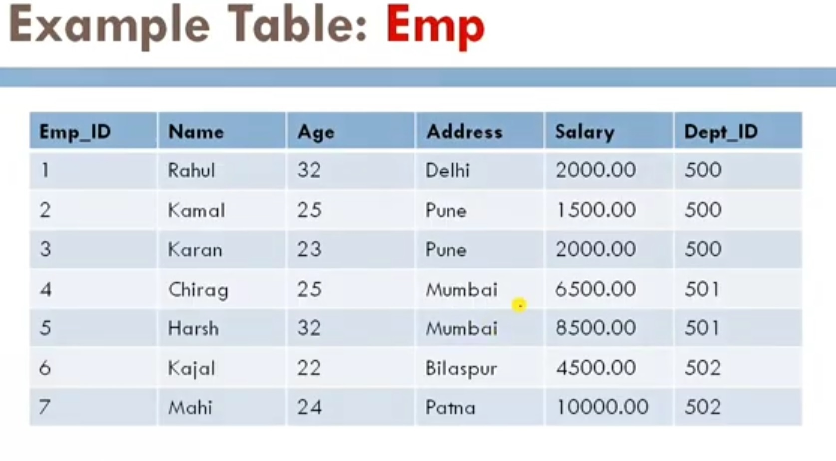

Slide 54
Write a query to find number of employee in each department.
Select Dept_id, Count(*)
From Emp2
Group By Dept_id;
Dept_id | Count(*)
500 | 3
501 | 2
502 | 2

Slide 55
Write a query to find the number of employee in each department, sorted low to high.
Select Dept_id, count(*)
From Emp2
Group by Dept_id
Order by count(*);

Slide 56
Write a query to find the sum of salaries of employees from each department .
Select Dept_id ,SUM(Salary) as ‘SumSalary’
From Emp2
Group by Dept_id
Write a query to find the average of salaries of employees from each department.
Select Dept_id, ROUND(Avg(Salary)) from Emp
Group by Dept_id;

Slide 57
Write the query to find the minimum salary of employee from each department
Select dept_id, Min(Salary)
From Emp2
Group by Dept_id;
Write the query to find the maximum salary of employee from each department.
both

Slide 58
HAVING
HAVING clause is used with GROUP BY clause & filter the groups created by the GROUP BY clause
Having clause enables you to specify conditions that filter which group results appear in the results.
Having clause was added to SQL because the aggregate functions cannot be used with the WHERE clause.
The WHERE clause places conditions on the selected columns, whereas the Having clause places conditions on groups created by the Group By clause.
In SQL query, HAVING clause is placed after the Group By clause.

Slide 59
Syntax
SELECT column1, column2, Aggregate Function FROM table_name
WHERE conditions (optional)
GROUP BY column1, column2
HAVING conditions
ORDER BY column1, column2;

Slide 60
Write a query to display departments where the number of employee is greater than 2
Select Dept_id, Count(*)
From Emp2
Group By Dept_ID
Having Count(*)>2;

Slide 61
Write a query to find the department for which the sum of salaries of employees is more than 10000.
Select Dept_ID, Sum(Salary)
From Emp
Group By Dept_id
Having SUM(Salary)>10000;

Slide 62
Write a query to find the sum of salaries of employee that lives at the same location
Select Address, SUM(Salary)
From Emp
Group By Address
Having COUNT(Address)>=2;

Slide 63
TCL: Transaction Control Language
These commands are to keep a check on other commands and their affect on the database.
These commands can annul changes made by other commands by rolling the data back to its original state. It can also make any temporary change permanent.

Slide 64
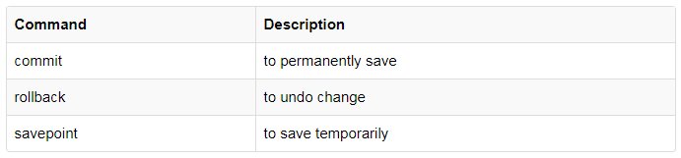

Slide 65
COMMIT command
COMMIT command is used to permanently save any transaction into the database.
When we use any DML command like INSERT, UPDATE or DELETE, the changes made by these commands are not permanent, until the current session is closed, the changes made by these commands can be rolled back.
To avoid that, we use the COMMIT command to mark the changes as permanent.
Following is commit command's syntax,
COMMIT;

Slide 66
ROLLBACK command
This command restores the database to last committed state. It is also used with SAVEPOINT command to jump to a savepoint in an ongoing transaction.
If we have used the UPDATE command to make some changes into the database, and realize that those changes were not required, then we can use the ROLLBACK command to rollback those changes, if they were not commited using the COMMIT command.
Following is rollback command's syntax,
ROLLBACK TO savepoint_name;

Slide 67
SAVEPOINT command
SAVEPOINT command is used to temporarily save a transaction so that you can rollback to that point whenever required.
Following is savepoint command's syntax,
SAVEPOINT savepoint_name;

Slide 68
DCL: Data Control Language
Data Control Language(DCL) is used to control privileges in Database.
To perform any operation in the database, such as for creating tables, sequences or views, a user needs privileges. Privileges are of two types,
System: This includes permissions for creating session, table, etc and all types of other system privileges.
Object: This includes permissions for any command or query to perform any operation on the database tables.
In DCL we have two commands,
GRANT: Used to provide any user access privileges or other privileges for the database.
REVOKE: Used to take back permissions from any user.

Slide 69
Create a user
create user <username> identified by "<password>";

Slide 70
Allow a User to create session
When we create a user in SQL, it is not even allowed to login and create a session until and unless proper permissions/privileges are granted to the user.
Following command can be used to grant the session creating privileges-
GRANT CREATE SESSION TO username;

Slide 71
Allow a User to create table
To allow a user to create tables in the database, we can use the below command,
GRANT CREATE TABLE TO username;

Slide 72
Grant permission to drop any table
As the title suggests, if you want to allow user to drop any table from the database, then grant this privilege to the user,
GRANT DROP ANY TABLE TO username

Slide 73
To take back Permissions
And, if you want to take back the privileges from any user, use the REVOKE command.
REVOKE CREATE TABLE FROM username

Slide 74
Sub query
E_ID | E_Name | Dept | Salary
1 | Ram | HR | 10000
2 | Amrit | MRKT | 20000
3 | Ravi | HR | 30000
4 | Nitin | MRKT | 40000
5 | Megha | IT | 50000

Slide 75
Write a SQL query to display maximum salary.
Select Max(Salary) from Emp;
Write a SQL query to display employee name who is taking maximum salary.(Subquery)
Select E_Name from Emp where Salary=(Select Max(Salary) from Emp);

Slide 76
Write SQL query to display second highest salary from Emp table
Select Max(Salary) from Emp where salary<>(select Max(Salary) from Emp);
Write SQL query to display employee name who is taking second highest salary.

Slide 77
Select E_Name from Emp where Salary=(Select Max(Salary) from Emp where Salary<>(Select Max(Salary) from Emp));

Slide 78
Write a query to display all the dept names along with its no. of emps working in that.
Select dept, Count(*) from Emp Group by dept;
Write a query to display highest salary department wise and name of emp who is taking highest salary.

Slide 79
Select E_name from Emp where salary IN (Select Max(Salary) from Emp group by dept);

Slide 80
Write a query to display all the dept names where no. of emps are less than 2.
Select dept from Emp Group By Dept having Count(*)<2;
Write a query to display name of employees where no. of employee less than 2.
Select E_Name from Emp where dept IN(Select dept from Emp Group By Dept having Count(*)<2);

